Slide 1

ERP Implementation for XMPS
Optimizing workflows with our comprehensive ERP solution.

Slide 2
Business Context:
XMPS specializes in providing managed printing services to hospitals and medical centers. XMPS owns and installs printing machines at client locations, ensuring continuous operation by handling maintenance, supplying ink, and replacing spare parts.
Installation & Ownership:
Maintenance & Support:
Consumables Supply:
Revenue Model:
XMPS provides ink and other necessary supplies for the machines.
XMPS generates revenue from selling paper used in the printing process.
XMPS installs its own printing machines at hospitals and medical centers.
XMPS is responsible for maintenance, repairs, and spare parts replacement to ensure smooth operation.
Clients purchase printing paper and medical films from XMPS to use with the machines.
Clients do not own the machines; they use them under a service agreement.
Technical support is provided as part of the service.

Slide 3
Problem Statement:
XMPS currently uses QuickBooks & Excel for accounting and warehouse management. However, the company faces challenges in accurately determining expenses for each client due to limitations in tracking costs associated with machine maintenance, consumables, and spare parts usage per client. This lack of precise expense allocation affects financial reporting, cost control, and profitability analysis. To address these challenges, Odoo will be implemented to provide a more integrated and detailed expense tracking system, ensuring better cost visibility, improved financial management, and enhanced decision-making.

Slide 4
Purchase Module:
Vendors
Products
Purchase Agreements
Units of Measure

Slide 5

Inventory Module: Warehouse Management
Cairo & Assiut & Hospital
Warehouse
Film, printers, spare parts, toners & Hospital
Manage warehouse locations.
Putaway Rules
Efficient stock placement.

Slide 6
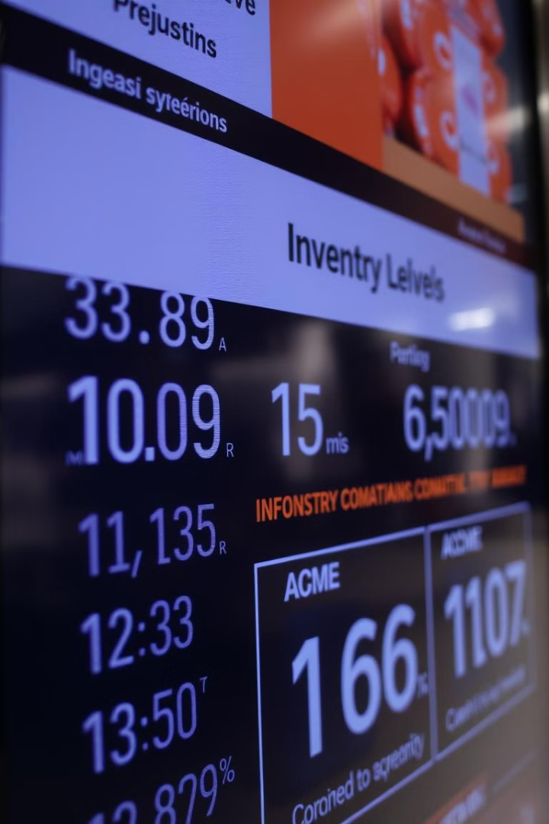





Inventory: Virtual Locations & Product Categories
Maintenance Account
Spare parts & toner tracking.
Printer Renewal
Renewal of depreciated assets.
Categories
Film, Printers, Spares, Toner.
Tracking serial number
For printers
Product Packagings

Slide 7




Expenses & Employee Management
Expense Category
Employee Creation
Technician Visits.
Technician profiles.
Project Assignment
Task tracking.

Slide 8







Accounting:
· Analytic Accounts
· Anglo Saxon
1
2
· Enable Automatic Accounting
Cash Journals for Assiut, Cairo and Miscellenous Journal for Printers.
7
3
· Chart of Accounts
6
4
· Asset reevaluation
5
· Asset Model

Slide 9



Project Management: Task Stages & Analytics
Task Stages
Workflow progress.
Analytic Accounts
Customer linked to project.
Top Bar
Key Performance Indicators.

Slide 10


Sales Module: Customer & Price Management
Customers
Price Lists
Client database.
Multiple pricing tiers.

